Slide 1
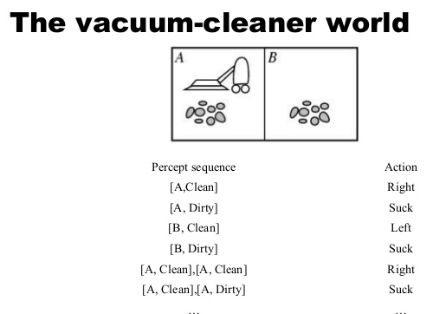
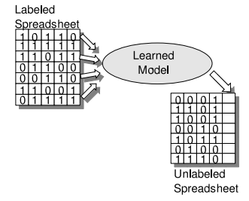
Artificial Intelligence
Deductive Learning
Machine Learning
Inductive Learning
Data Mining
Text Mining

Slide 2
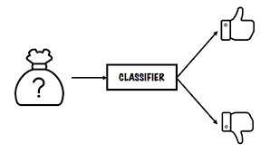
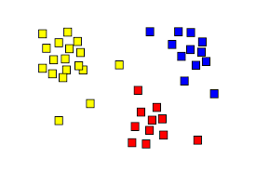
Machine Learning
Classification (Supervised Learning)
Clustering (Unsupervised Learning)

Slide 3
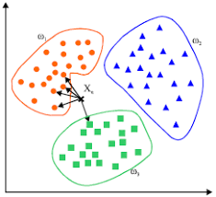

1. K-Nearest Neighbors Classifier
K-NN classifier finds k nearest neighbors from training data and vote among them
Manhattan $Dist\left(x,y\right)=\left|x_{1}−y_{1}\right|+\left|x_{2}−y_{2}\right|+…+\left|x_{n}−y_{n}\right|$
Euclidean $Dist\left(x,y\right)=\sqrt{\sum_{i=1}^{n}{{(x_{i}−y_{i})}^{2}}}$
$\cos\left(Ө\right)=\frac{\sum_{i=1}^{n}{x_{i}y_{i}}}{\sqrt{\sum_{i=1}^{n}{x_{i}}}×\sqrt{\sum_{i=1}^{n}{y_{i}}}}$

Slide 4
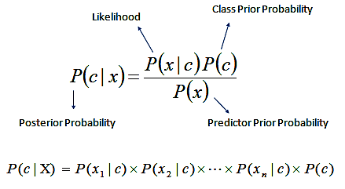



2. Naïve Bayes Classifier
$$P\left(C_{i} | d\right)=\frac{P\left(d | C_{i}\right)P(C_{i})}{P(d)}$$
$$P\left(C_{i} | d\right)=\frac{\prod_{j}{P\left(d_{j} | C_{i}\right)}P(C_{i})}{P(d)}$$
$$P\left(C_{i} | d\right)=\frac{\sum_{j}{logP\left(d_{j} | C_{i}\right)}P(C_{i})}{P(d)}$$

Slide 5
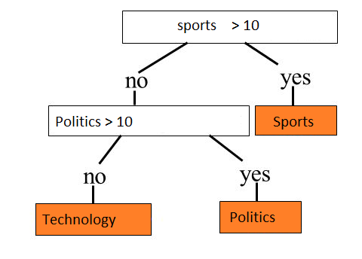


3. Decision Tree Classifier
$$E\left(S\right)= \sum_{i=1}^{c}{−p_{i}}\log_{2}p_{i}$$
$$Gain\left(S\right)=E\left(S\right)−E\left(n_{1}\right)E(n_{2})$$

Slide 6
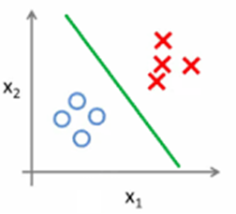
4. Linear Classifier
Draw a straight line among the two types (label) of documents
The test document is labeled based on which side of the line it lies.
w₀+w₁x₁ + w₂x₂ = b

Slide 7
Concluding Remarks
Nearest Neighbors Approaches
Probabilistic Approaches
Logic based Approaches
Weights based Approaches
Instance based vs Model based Classifiers
Parametric vs Non-parametric Classifiers

